Slide 1


LEAF ANATOMY AND FUNCTION

Slide 2

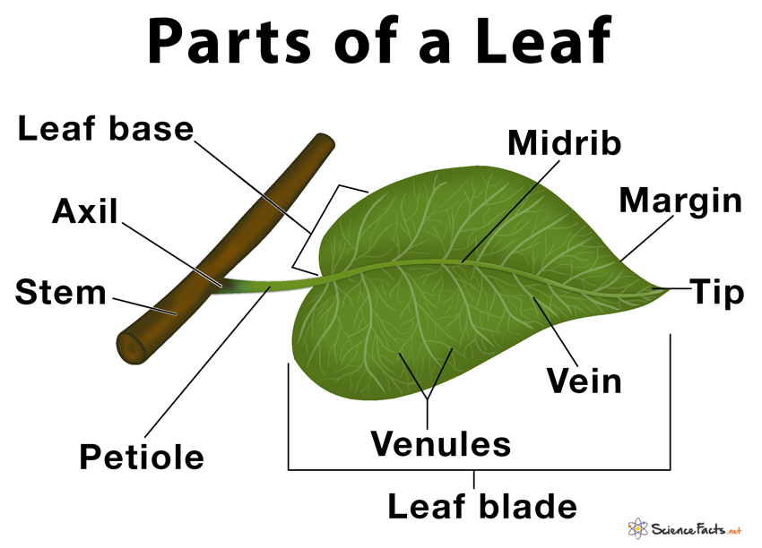
Leaf Structure

Slide 3
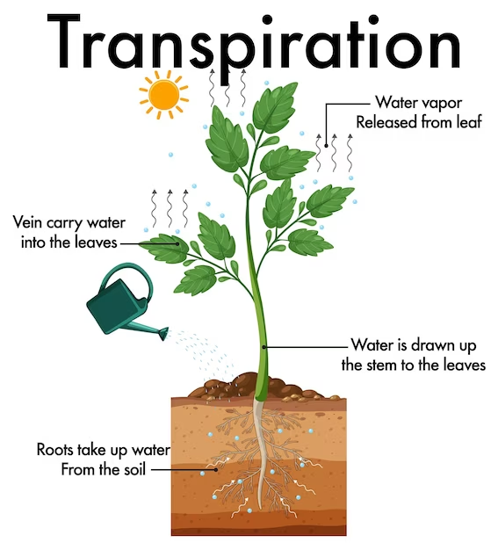

Slide 4
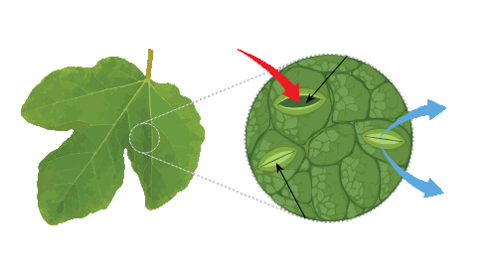
Gas Exchange
C02
open stoma
H20
O2
Closed stoma

Slide 5
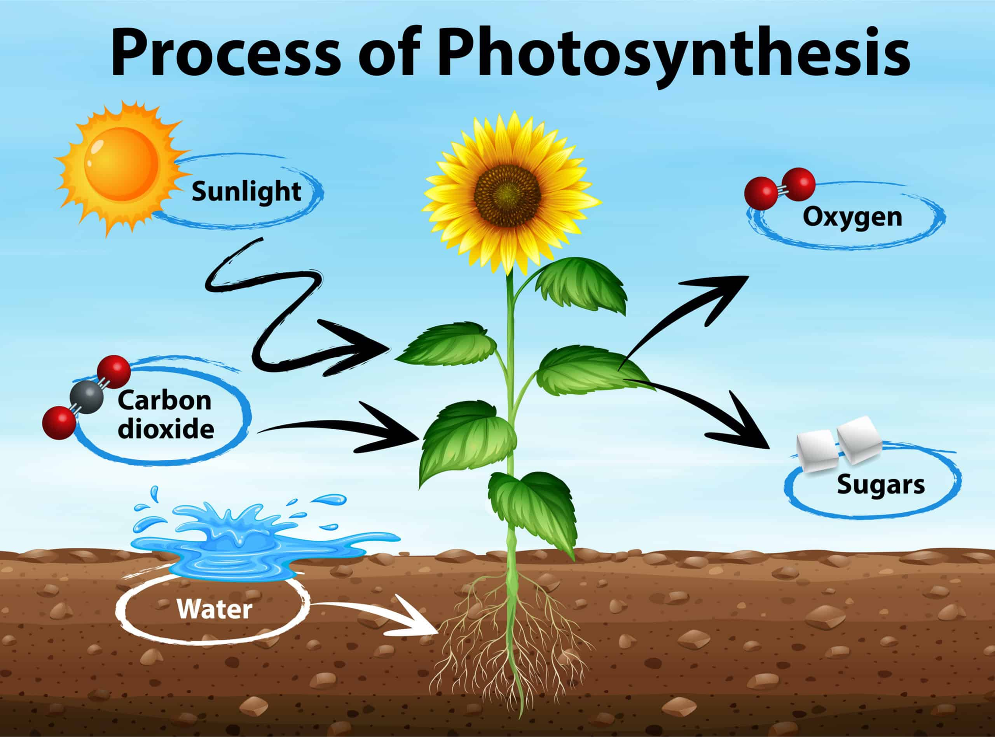

Slide 6
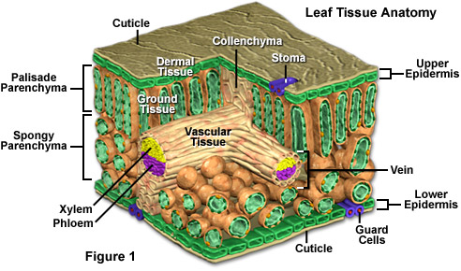
Leaf tissues Cross-section

Slide 7

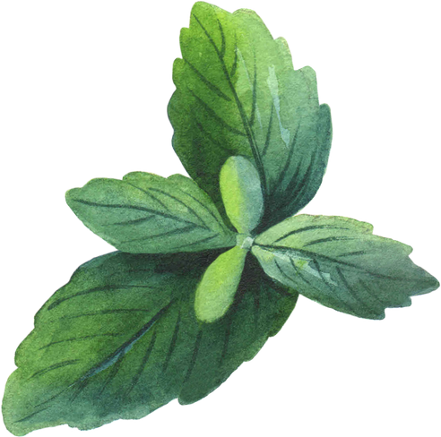
QUESTIONS

